Slide 1
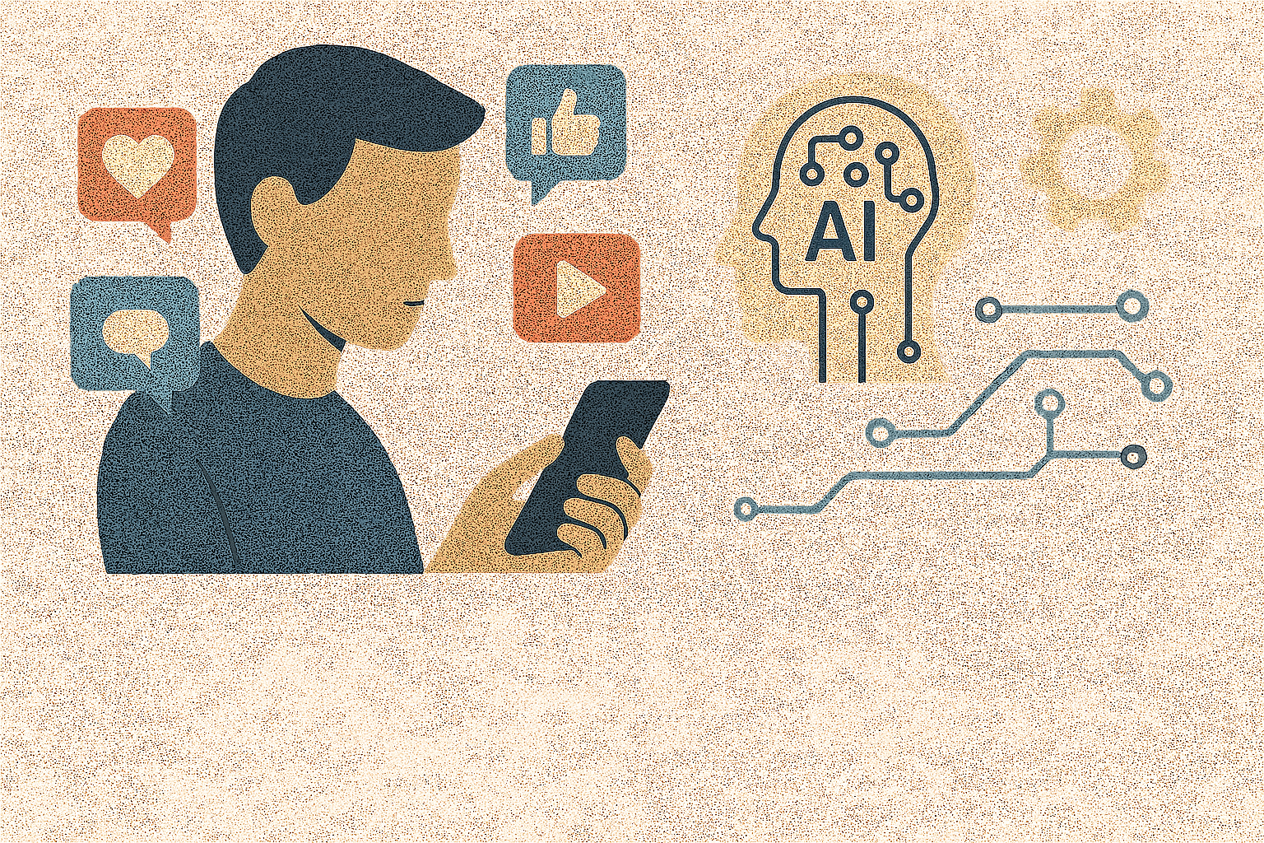
B.JYOSHNA
B.VAISHNAVI
A.SRUJANA
A.DIVYA
B.VARSHA
AI SOLUTIONS FOR SOCIAL MEDIA ADDICTION AND MISUSE

Slide 2

Understanding Social Media Addiction & Misuse
Social media addiction is characterized by excessive use that interferes with daily life and mental health.
Misuse can include cyberbullying, misinformation, and privacy violations, impacting users' well-being.
Recognizing these issues is essential for developing targeted AI-driven solutions to promote healthier social media habits.

Slide 3
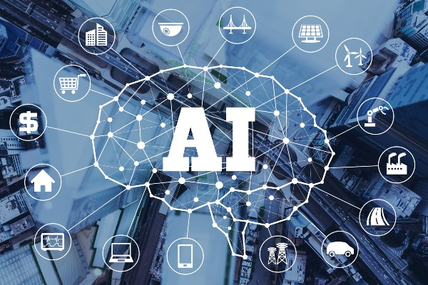
AI-Driven Monitoring & Personalization
AI algorithms can analyze user behavior to detect signs of addictive patterns and misuse.
Personalized interventions can be delivered based on individual usage data to encourage moderation.
This proactive approach helps users become aware of their habits and adopt healthier social media practices.
2

Slide 4
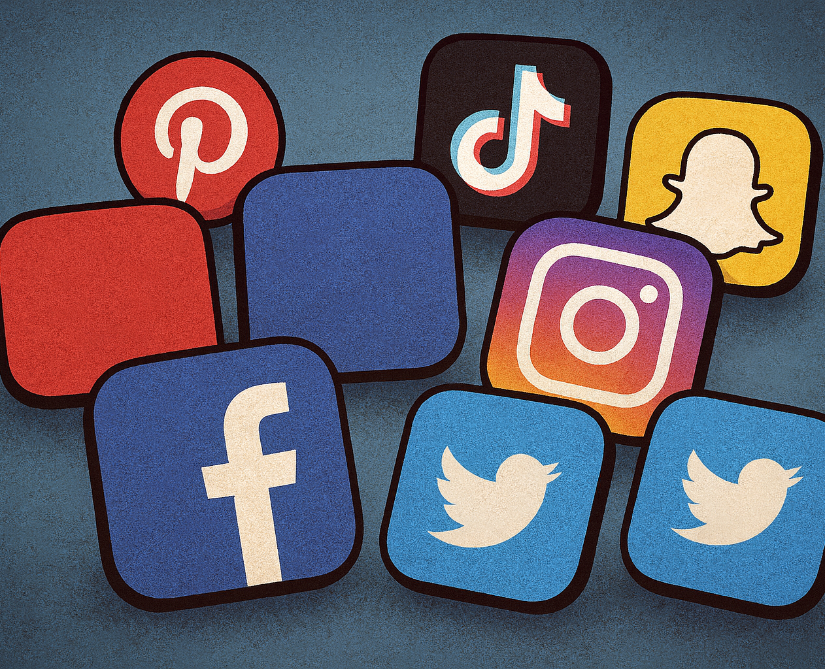
AI-Driven Detox Engine & Intervention Tools
An AI-powered detox engine can suggest customized breaks or limit access to reduce overuse.
Real-time alerts and motivational prompts support users in managing and decreasing their screen time.
These tools promote sustainable usage habits and aid users in overcoming dependency.

Slide 5
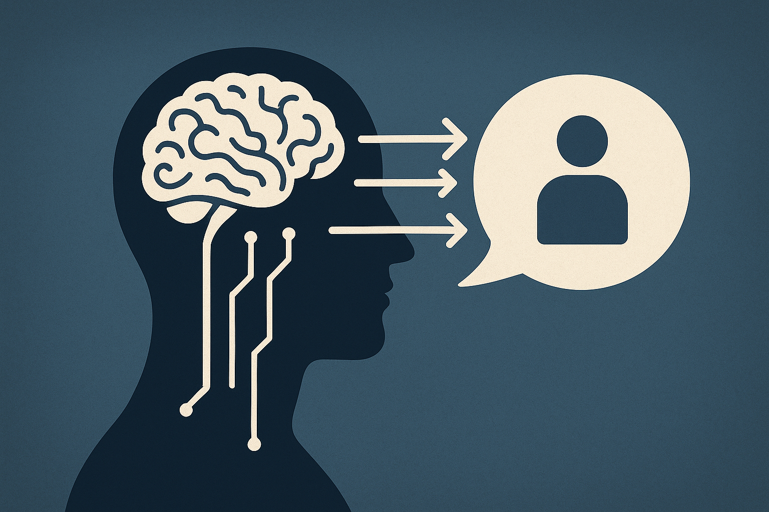
Introduction to AI-Driven Behavioral Prediction
AI-driven behavioral prediction utilizes machine learning algorithms to analyze patterns in user data to forecast future actions.
These techniques can identify subtle behavioral changes that may indicate emerging issues, including addiction.
The goal is to provide timely interventions and personalized support to mitigate risks effectively.

Slide 6
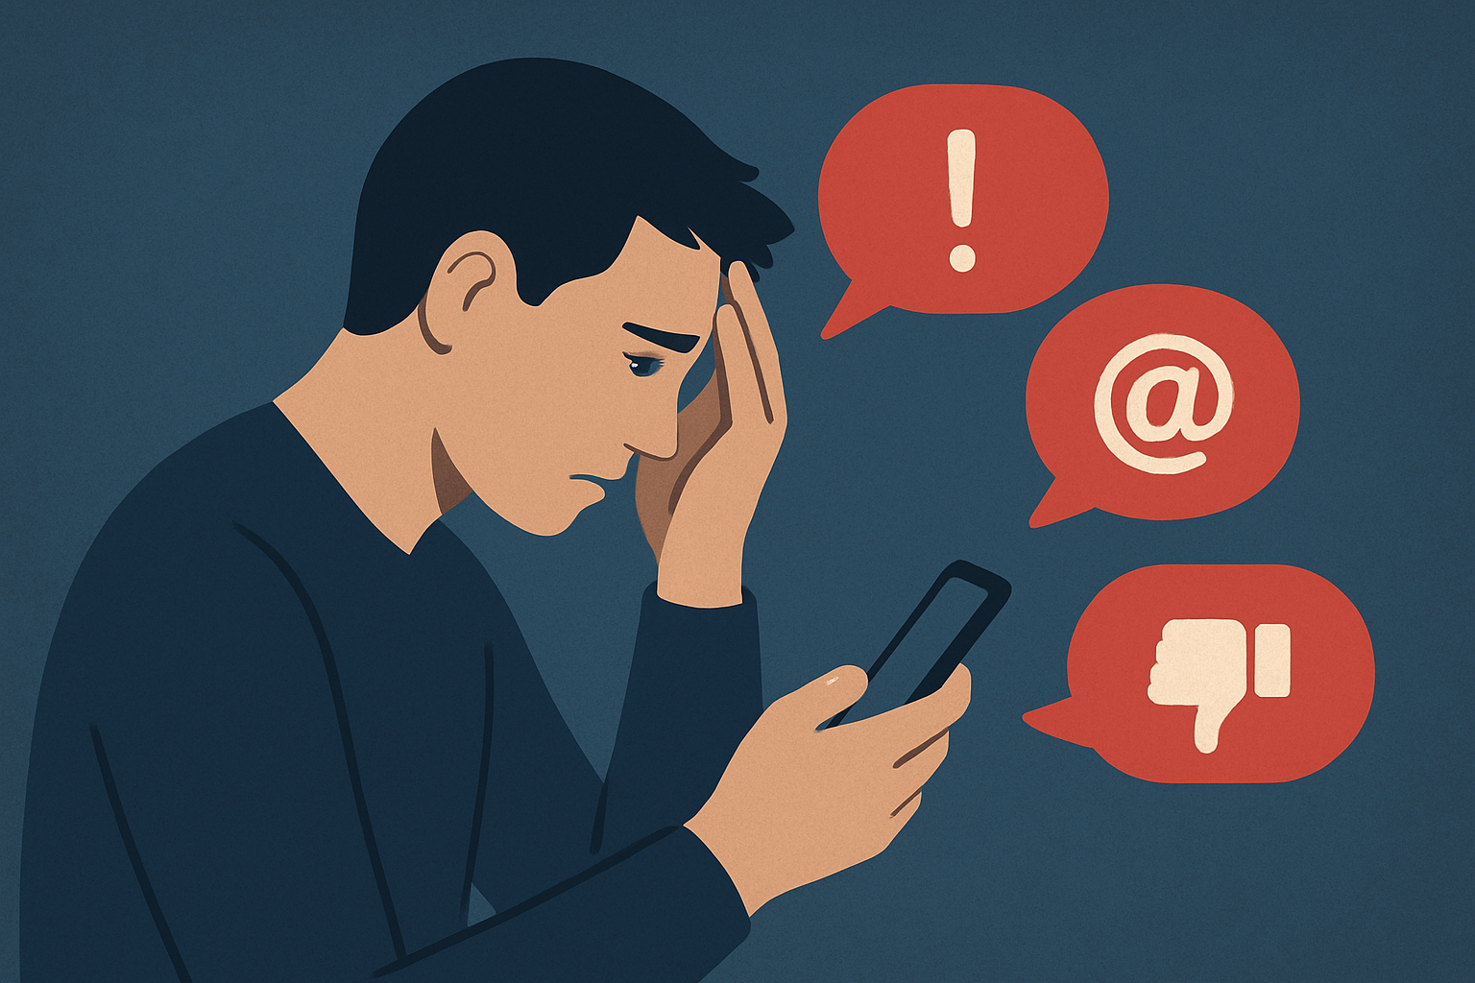
Understanding Early Addiction Warning Signs
Early warning signs of addiction include increased usage frequency, emotional reliance on substances or behaviors, and neglect of responsibilities.
AI models can detect these signs by monitoring digital activity, social interactions, and physiological data.
Accurate identification of these indicators enables proactive measures to prevent the progression of addiction.

Slide 7
AI Technologies and Methodologies
Natural language processing (NLP), anomaly detection, and predictive analytics are core AI techniques used in this field.
Data sources include mobile app usage, wearable devices, social media activity, and electronic health records.
Combining multimodal data enhances the accuracy of behavioral predictions and early warnings.
THANK YOU

